Slide 1
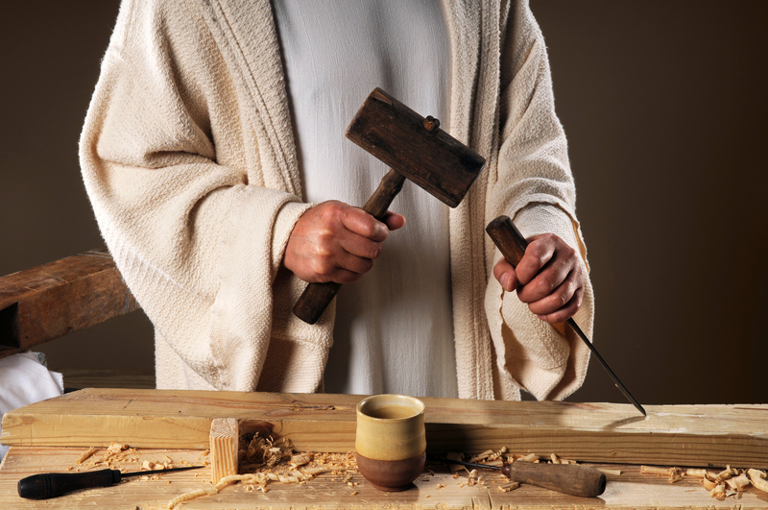
Be Working
The Letter
of James
Dr. Rick Griffith • Crossroads International Church Singapore
BibleStudyDownloads.org

Slide 2
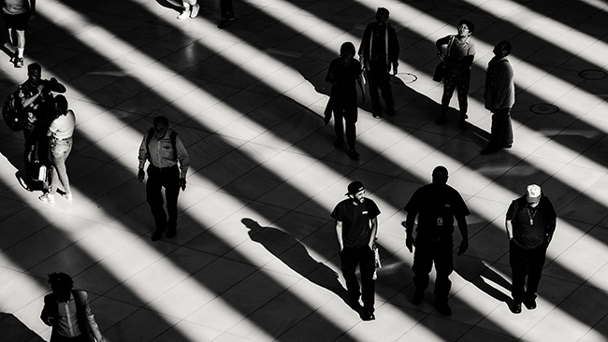
Faith is internal and unseen.
Or is it?
Notes:
Some years ago I sat on a plane next to an older man. He looked about 70 years old, but his eyes sparkled as we talked and he spoke with great energy and many smiles. I thought to myself, “Wow, I hope I have half his energy when I get to his age!” So I asked him his age. “Oh, I am 85 this year!”
That got me even more interested. “Hey, I bet this man is a Christian.” But I will first ask what he did all his working years.
“Oh, for most of my life I was a bookie” he said.
I thought, “What? You spent decades managing horse races that destroyed how many men, how many families, and made a lot of money off gamblers who look like a wreck—but you look fantastic!”
Hmmmmm, it made think of this further thought:
• Faith is internal and unseen. You can’t really tell by looking a a person if he or she is a Christian, can you? I have met other delightful men who I was sure were Christians, but then they told me, “Oh, I am a Mormon” or I found out they were into Eastern philosophy or whatever ism.
• But is faith really only internal? Can’t we tell in other ways if a person has faith in Christ?

Slide 3

How will others know you are a Christian?
Notes:
Will you have a special glow?
Do Christians smile more?

Slide 4
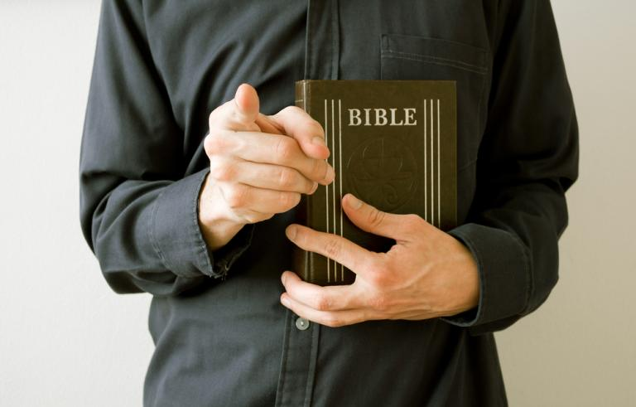
How will others know you are a Christian?
Notes:
Should we try to get others to ask about our faith by seeing religious disciplines in us like prayer and Bible reading?
What if we tell people what the Bible says?

Slide 5
What are the characteristics of faith?
Notes:
What should your trust in Christ look like?
What does faith in Jesus look like?

Slide 6
Background
Early Jewish believers were not living out their faith.

Slide 7
NT Overview (General + Key Words)
What books have we studied so far?
38
124
39-41
What are their key words?
"To the remotest part of the earth" (Acts 1:8)
Acts 9 13 14 15 16 18 21 27 28
Put them in chronological order!
Apr 48-
Sep 49
1
Galatia
Apr 50-
Sep 52
2
Aegean
Spr 53-
May 57
3
Asia
Feb 60-
Mar 62
1
Rome
Spr 62-
Fall 67
4
Spain
Aut 67-
Spr 68
2
Rome
Summer 35-
37
Damascus
Antioch
May 57-
Aug 59
Trials
Fall 49
The
Council
Spring 68
Expansion of Church
35 48 49 50 52 53 57 60 62 67 68 95
Matt
Kingdom
James
Works
Gospels & Acts
1234
Journeys
General Epistles
Rome
Imprisonments
General Epistles + Key Words
Notes:
In pairs, the taller person give the five books we have studied so far in chronological order then the shorter person give the key words.
Today we begin studying the General Epistles, but only briefly since after James we won't get to the second one for a long time!
The key word for James is works.

Slide 8

The Title
EPISTLE OF
JAMES
BOND
servant
Of Christ Jesus

Slide 9
Summary Statement
267
Early Jewish believers in the Roman world should show their faith through works to replace their hypocrisy with good deeds in maturity and holiness.
WORKS

Slide 10
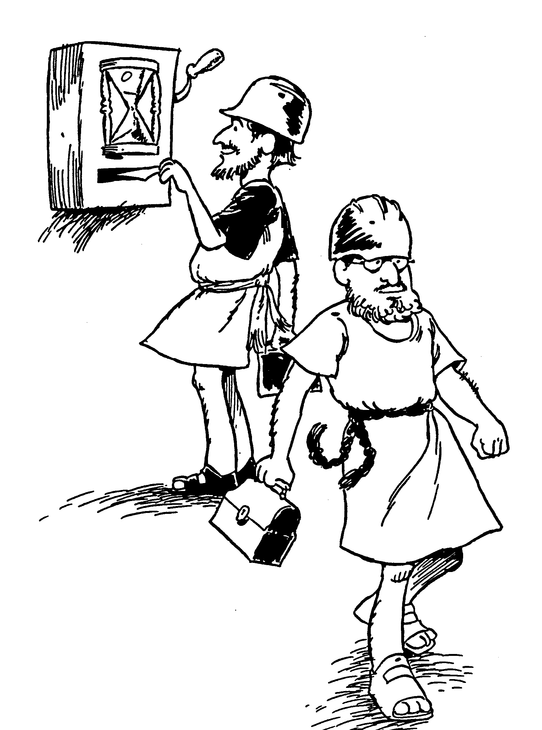
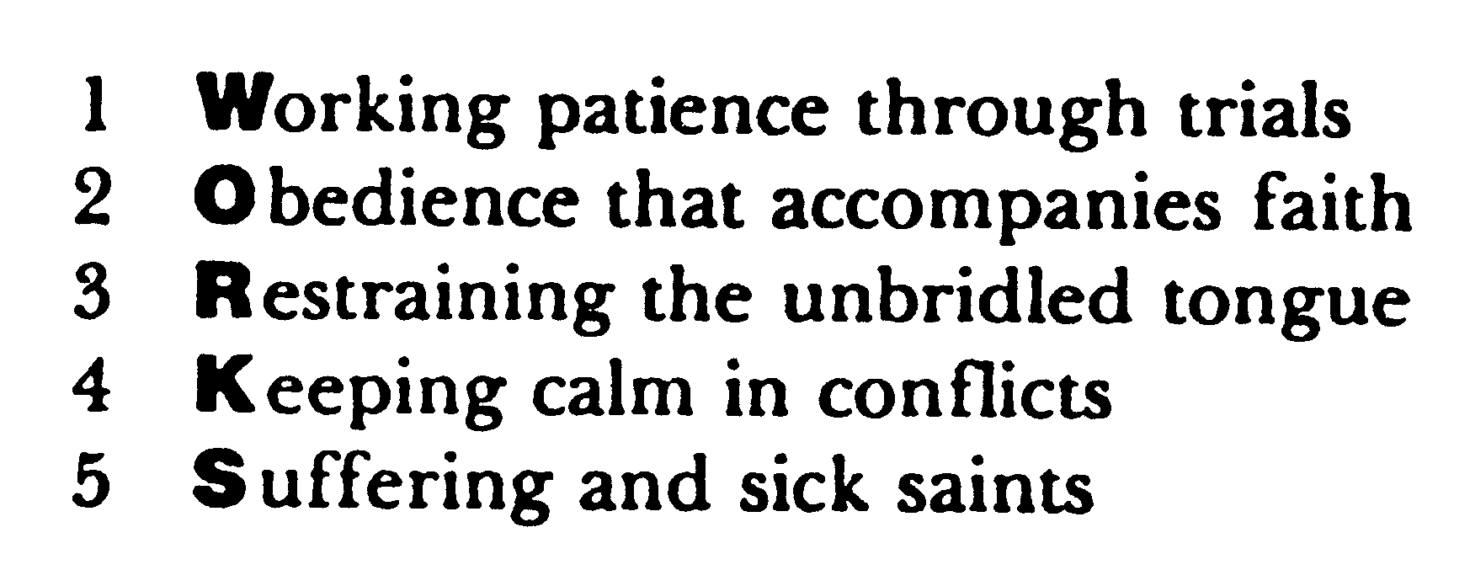
Huddleston Outline
WORKS

Slide 11
Authorship: James the son of Zebedee?
Authorship
James the son of Zebedee
Died before letter was written

Slide 12
Son of Thaddeus or Alphaeus
Authorship
James the son of Alphaeus
James the father of Thaddeaus

Slide 13
The Family of Jesus
Holy
Spirit
Men in white
Mary
Joseph
Women in yellow
Jesus
Joseph
Simon
Sister 2
James
Judas
Sister 1
"Then they scoffed, 'He's just a carpenter, the son of Mary and the brother of James, Joseph, Judas, and Simon. And his sisters live right here among us.' They were deeply offended and refused to believe in him" (Mark 6:3 NLT).

Slide 14
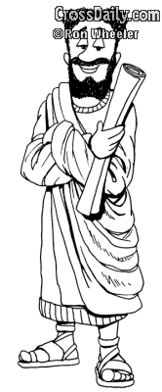
Brother of Jesus
Authorship
James the brother of Jesus
What would it have been like to grow up with a perfect older brother?

Slide 15
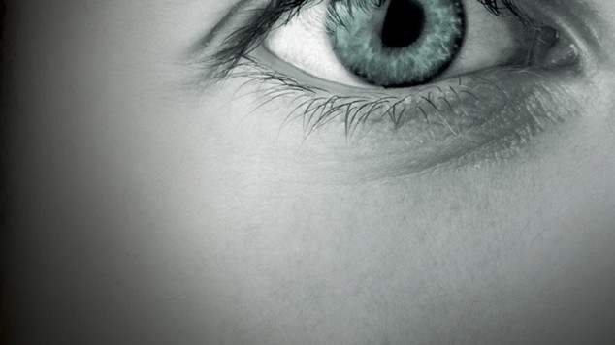
Who were the original readers of James?
Were they believers or not?
How do you know?

Slide 16
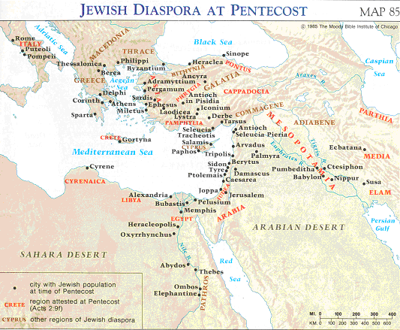
Jewish Diaspora at Pentecost
See Acts 2:9-11
Addressed To
"To the twelve tribes scattered among the nations..."
James 1:1

Slide 17
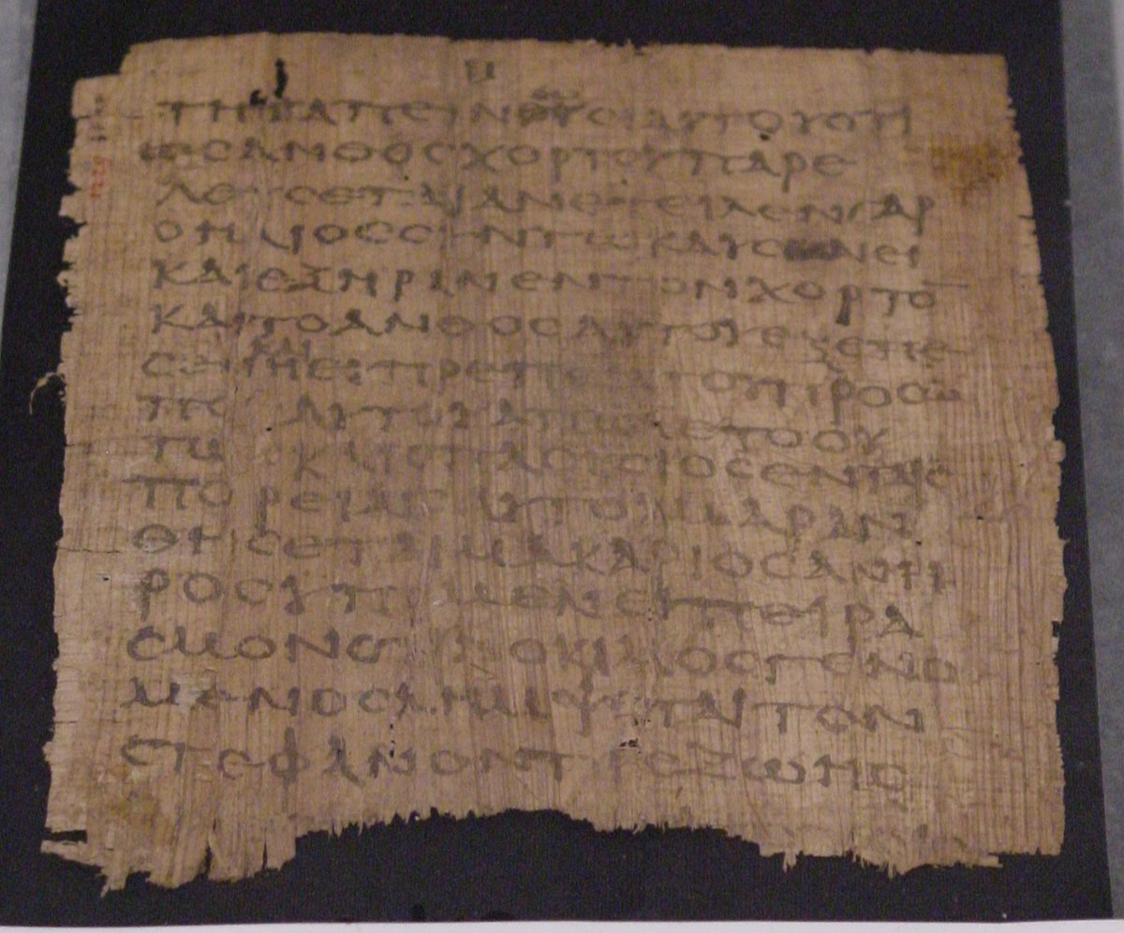
Why did James write?
To lead unbelievers to Christ
To give “tests of faith” so people could evaluate if they were genuine believers
To exhort true Christians to live up to the faith they professed

Slide 18
What are the characteristics of faith?
7
Notes:
What should your trust in Christ look like?
What does faith in Jesus look like?

Slide 19
James Shows Ways Faith is Seen…
267

Slide 20
Slides on
James 1

Slide 21
James Shows Ways Faith is Seen…
267

Slide 22
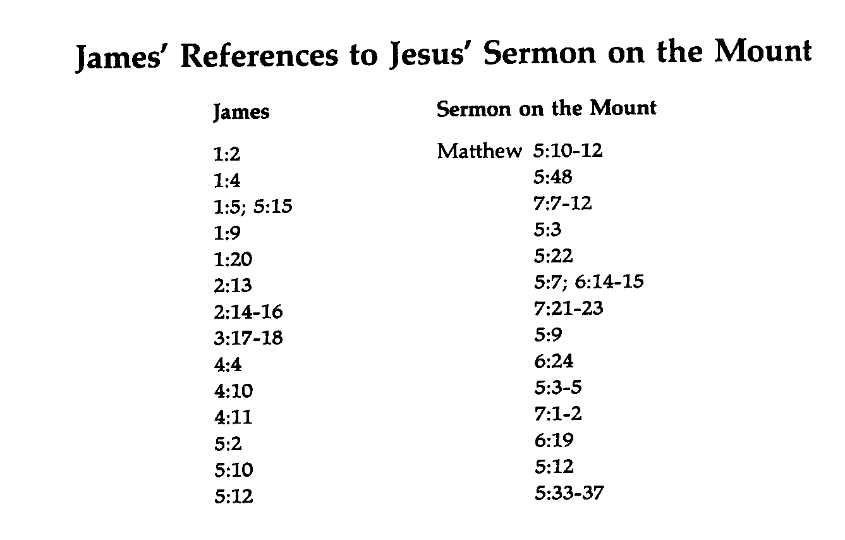
James' References to the Sermon on the Mount
274a
James
Sermon on the Mount
Matthew

Slide 23

Trials, Temptation and Sin
(James 1:2-18)

Slide 24
Faith accepts trials with joy because it believes that God allows testing to develop perseverance and maturity (2-4).

Slide 25
What is the path from trials to joy?
Testing of Faith
when finished
Trial
Perseverance
Mature
&
Complete
Endure
(JOY)
James 1:2-4

Slide 26
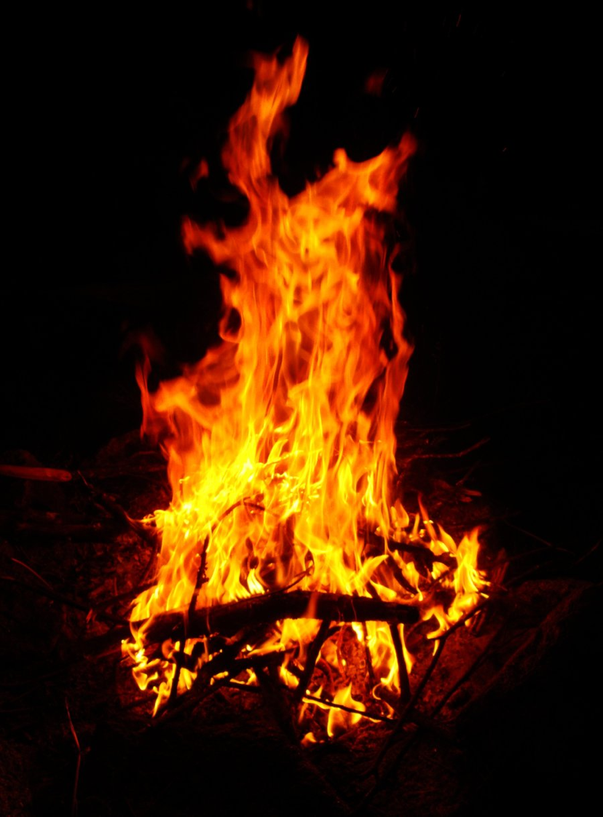
The Fire
    I've been through a fire that has deepened my desire
    to know the living God more and more.
    It hasn't been much fun but the work that it has done
    in my life has made it worth the hurt.
    You see, sometimes we need the hard times
    to bring us to our knees.
    Otherwise, we do as we please
    and never seek him.
    But He always knows what's best
    And it's when we're in the test
    that we really come
    to know God as He is.

Slide 27
James Shows Ways Faith is Seen…
267

Slide 28
Slides on
James 2

Slide 29
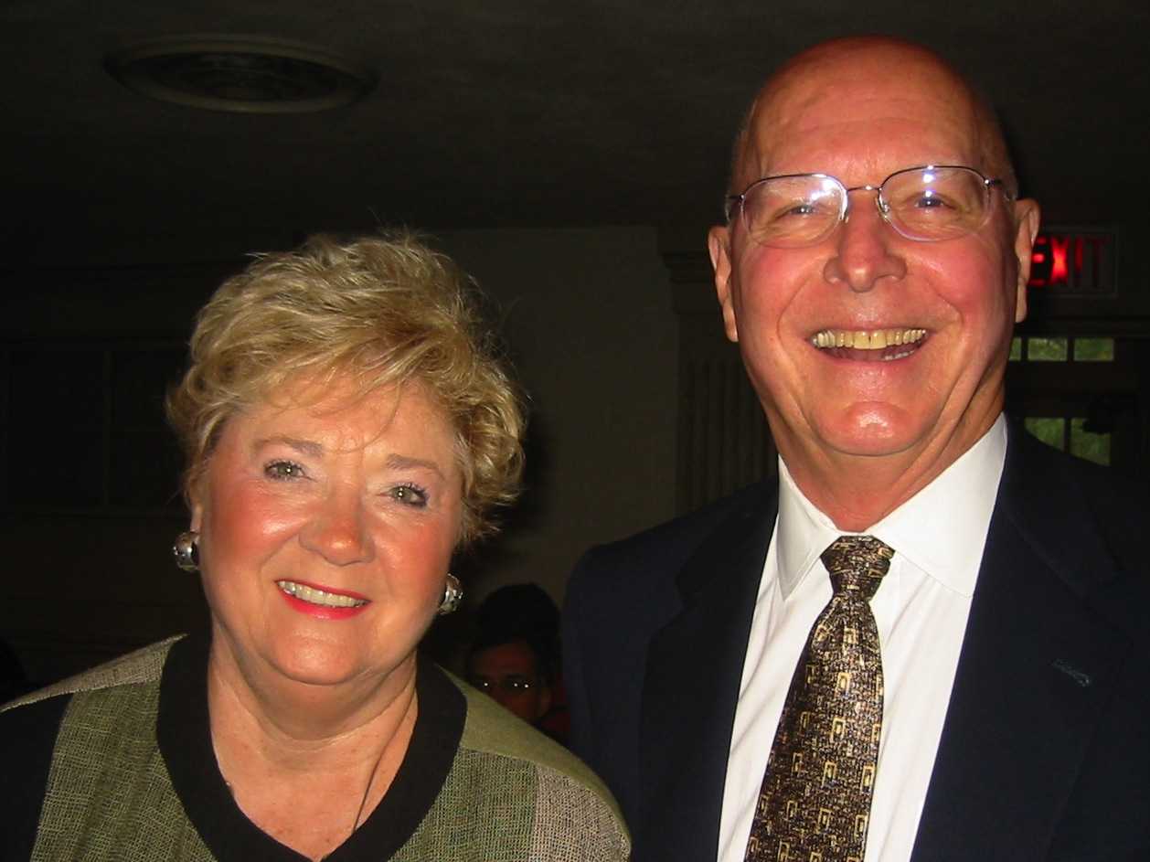
Mr. & Mrs. Miles
Notes:
Mr. & Mrs. Miles have been blessed financially by God. I found it tempting to want to see them at church. This also tempted the early Jewish believers in James 2.

Slide 30
James Shows Ways Faith is Seen…
267

Slide 31
"My brothers, as believers in our Lord Jesus Christ, don't show favoritism."
James 2:1
Don't favor the rich!

Slide 32
Why not favor the rich?

Slide 33
Favoring the rich…
Our outline of James 2…
Indicates impure motives (2-4)

Slide 34
What is favoritism?
"preferential treatment, especially when unjust or narrowly discriminating"
(Funk & Wagnalls)
to treat another person based upon his financial status and from an improper motive
(James 2:4)

Slide 35
Favoring the rich…
Our outline of James 2…
Indicates impure motives (2-4)
Insults the poor (5-6a)

Slide 36
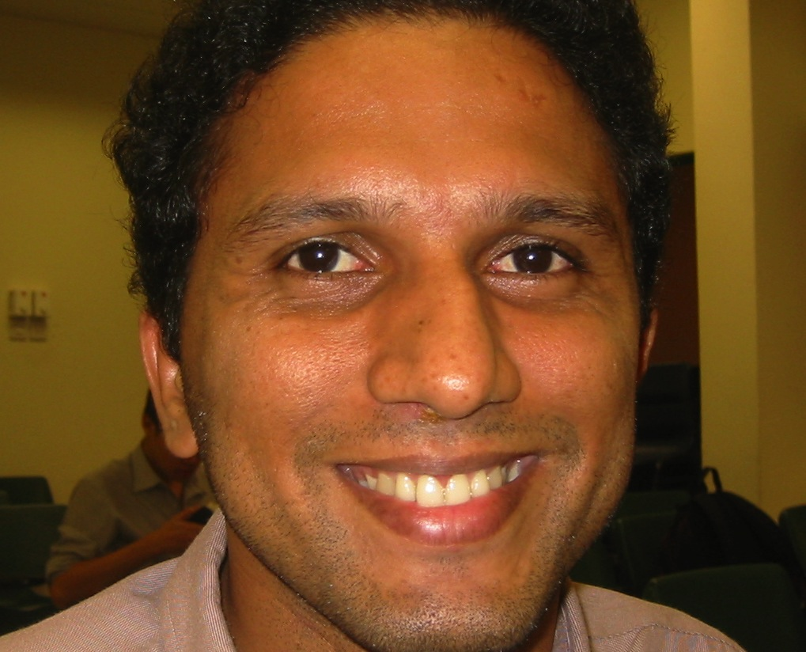
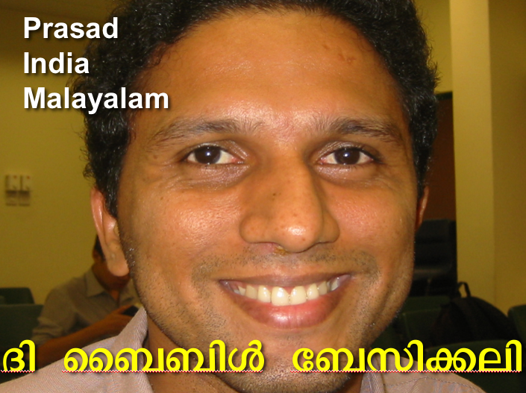
Malayalam
Prasad
India
Malayalam
Æß èÌÌßZ çÌØßAÜß

Slide 37
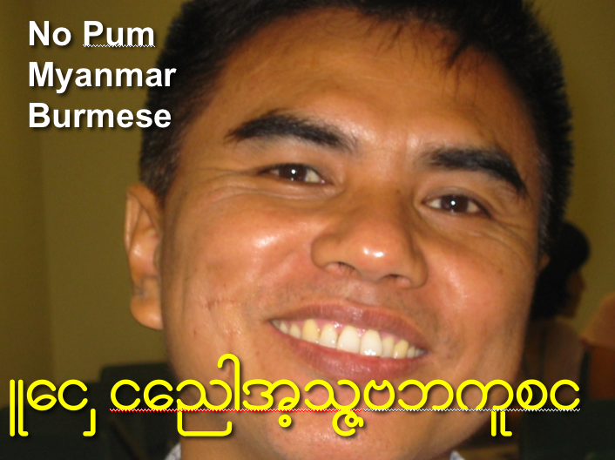
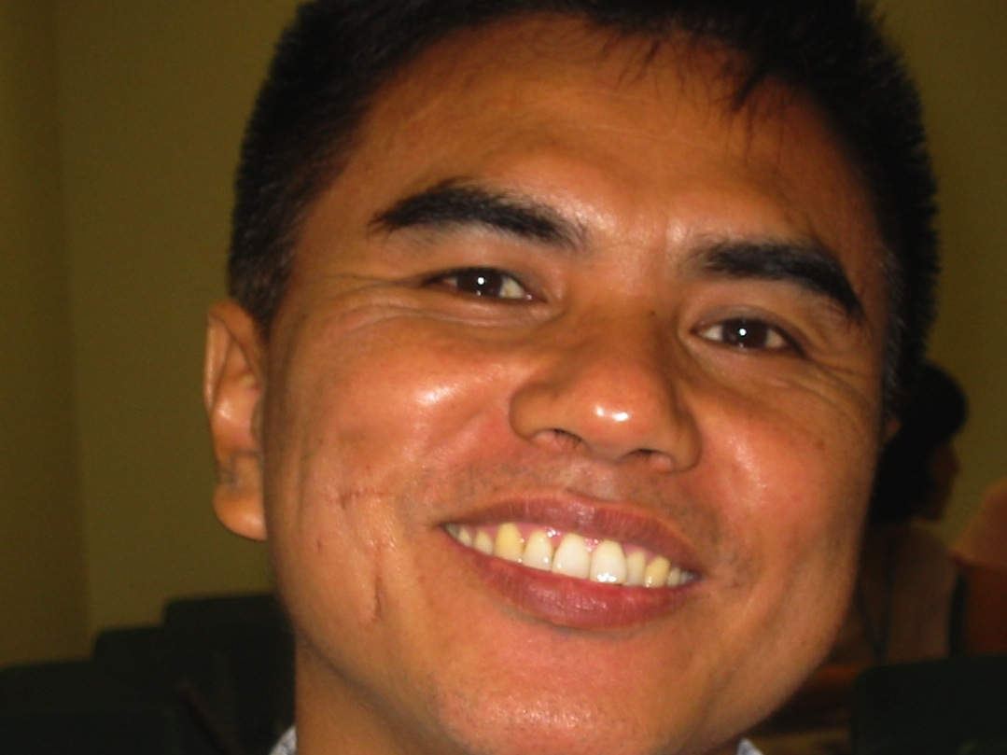
Burmese
No Pum
Myanmar
Burmese
Lai Siangtho…Abulpi

Slide 38
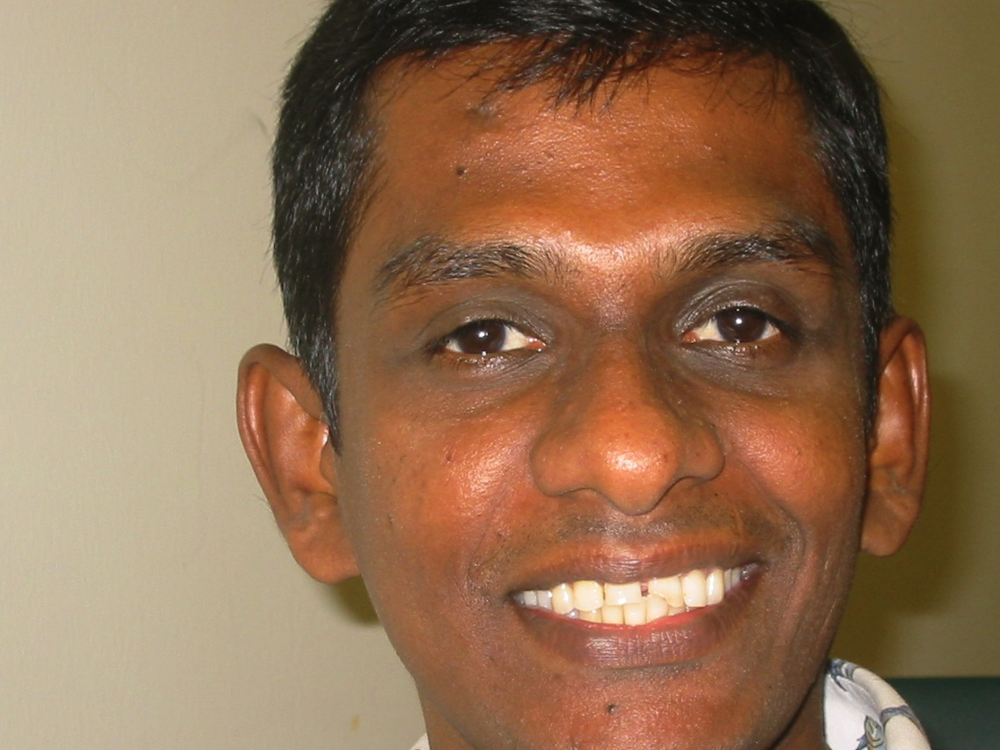
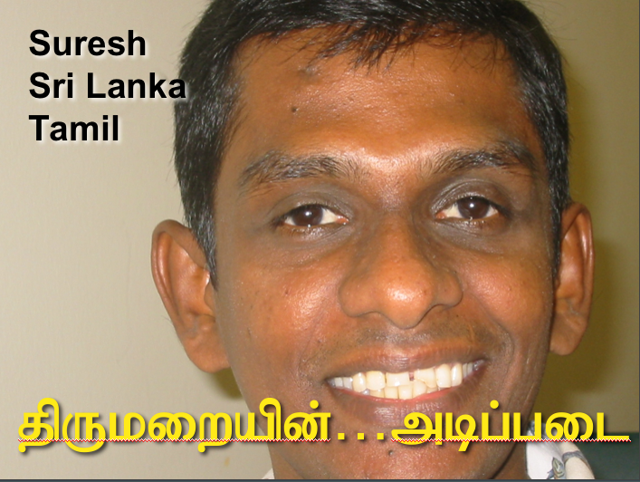
Tamil
Suresh
Sri Lanka
Tamil
jpUkiwapd;…mbg;gil

Slide 39
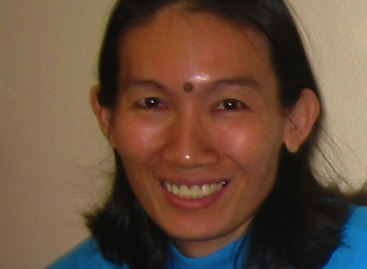

Cambodian
Sokheang
Cambodia
Khmer
mUldæanRKw³énRBHKm<Ir

Slide 40
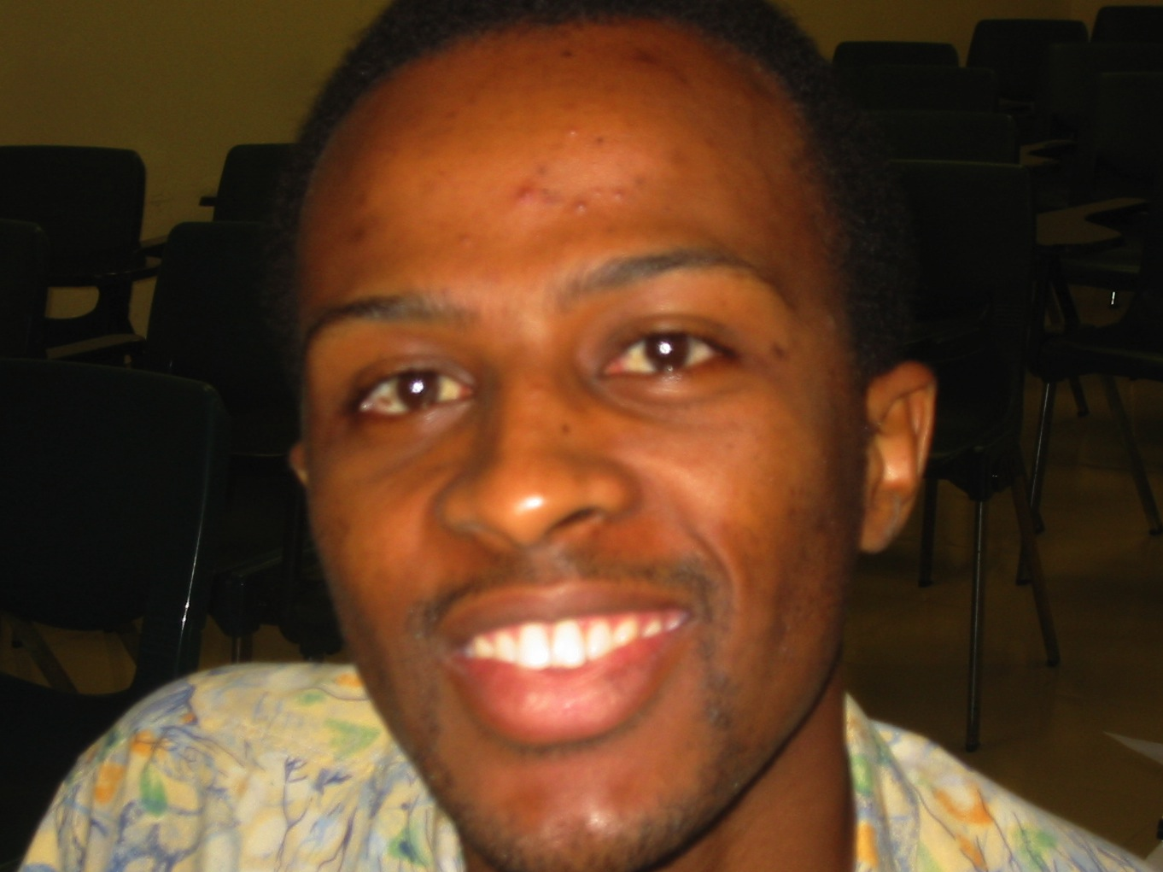
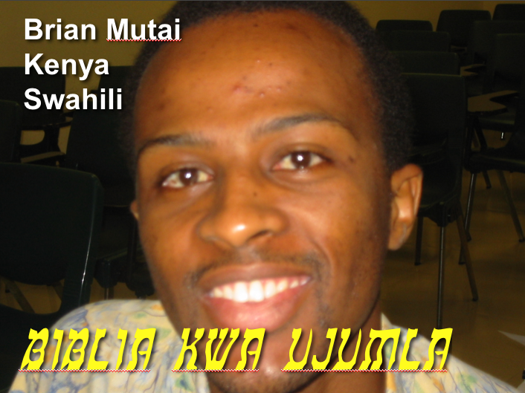
Swahili
Brian Mutai
Kenya
Swahili
biblia kwa ujumla

Slide 41
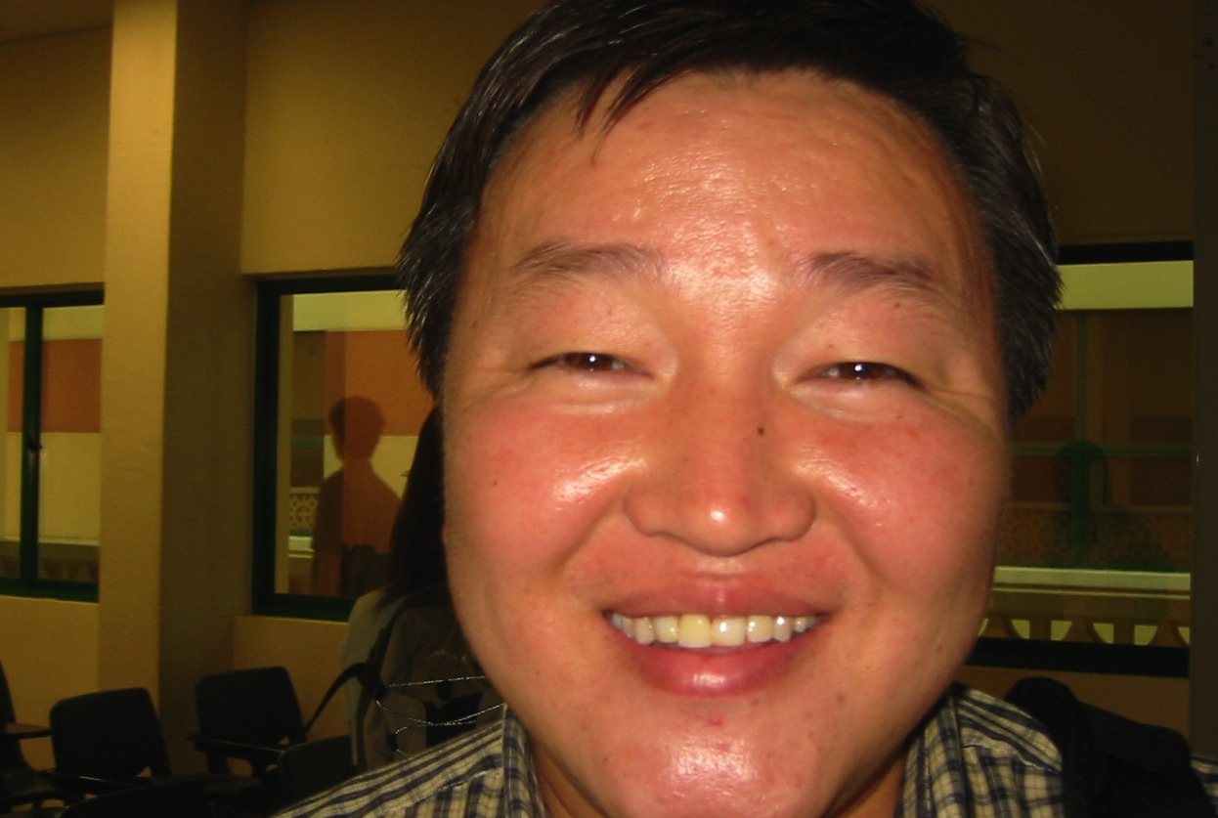
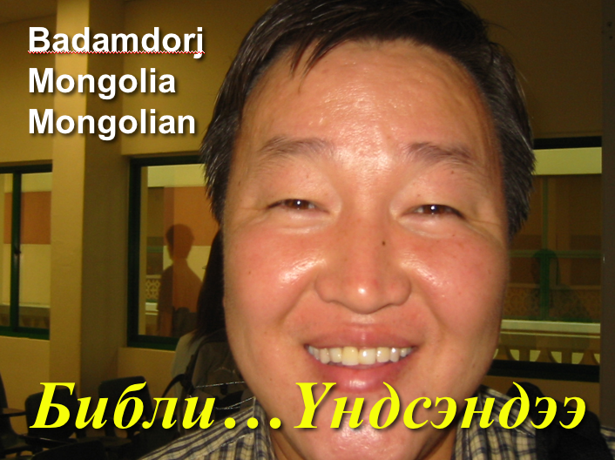
Mongolian
Badamdorj
Mongolia
Mongolian
Библи…Үндсэндээ

Slide 42
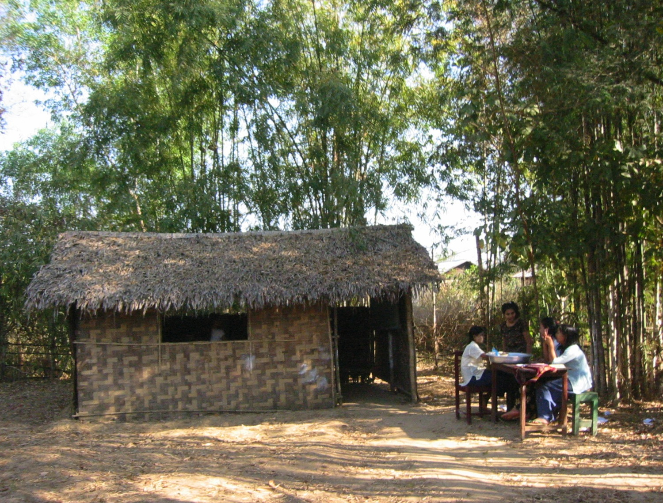
No Pum's Classroom (Myanmar)

Slide 43
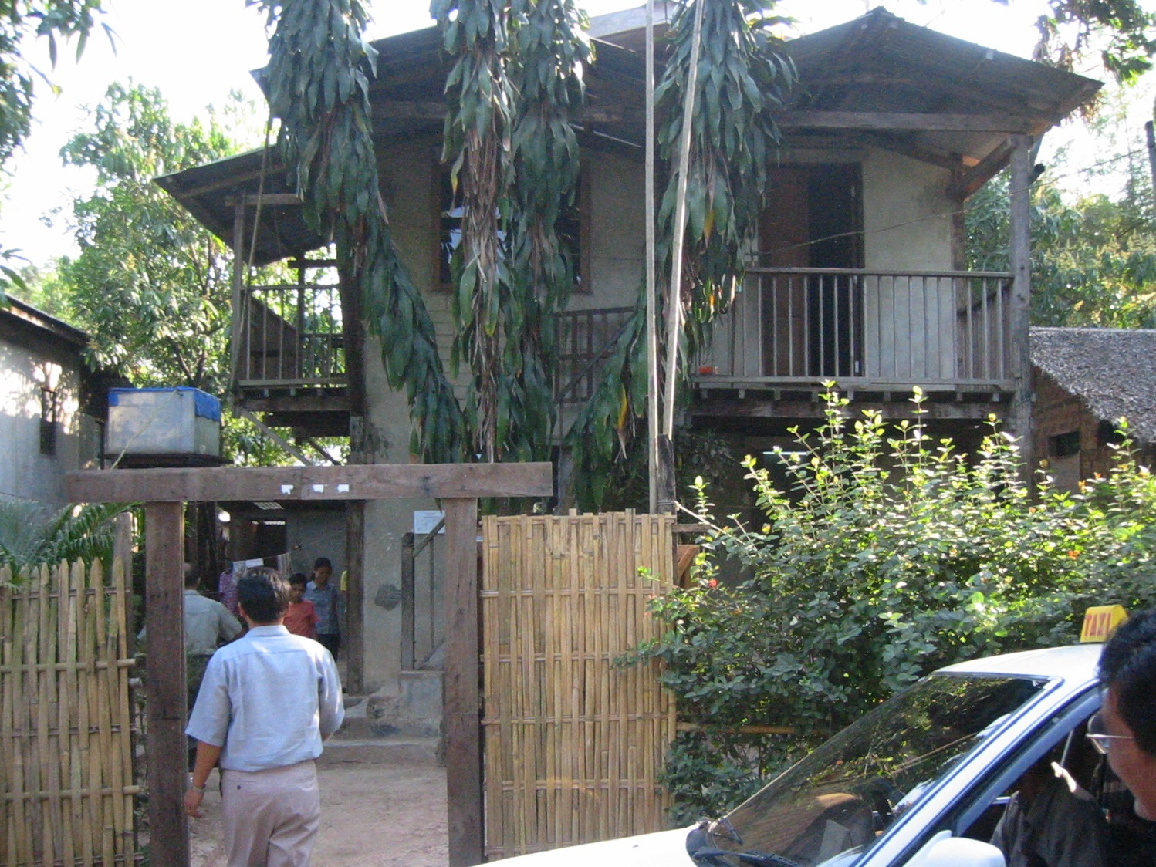
No Pum's Home (Myanmar)

Slide 44
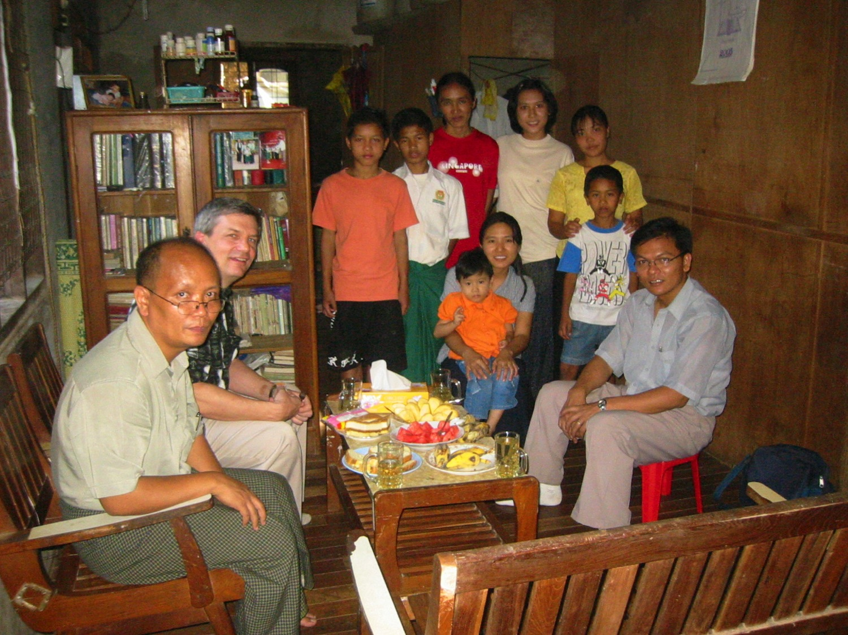
No Pum's Orphans (Myanmar)

Slide 45
Favoring the rich…
Our outline of James 2…
Indicates impure motives (2-4)
Insults the poor (5-6a)
Indulges oppressors (6b-7)
Ignores God's command to love others like ourselves (8-11)
Incurs God's judgment (12-13)

Slide 46
May I probe?
Do you treat people alike—rich or poor? Or do you give the wealthy special attention?
Whom do you invite for lunch or dinner? Is it always someone who's equal or better off than you financially?
Do you show kindness to those who can't reciprocate?
Do you love and serve the more needy in this church? Or is your time absorbed by the others?

Slide 47
James Shows Ways Faith is Seen…
267

Slide 48
Do all true Christians die in fellowship with the Lord?
In other words, do you think everyone perseveres in his or her faith or do they sometimes fall away?
What is the key issue here?

Slide 49
The Apparent Contradiction Between
Paul and James on Faith and Works
"For we maintain that a man is justified by faith apart from observing the law"
(Romans 3:28)
"In the same way, faith by itself, if it is not accompanied by action, is dead"
(James 2:17)
??
"…a man is not justified by observing the law but by faith in Jesus Christ…"
(Galatians 2:16)
"You see that a person is justified by what he does and not by faith alone"
(James 2:24)
??

Slide 50
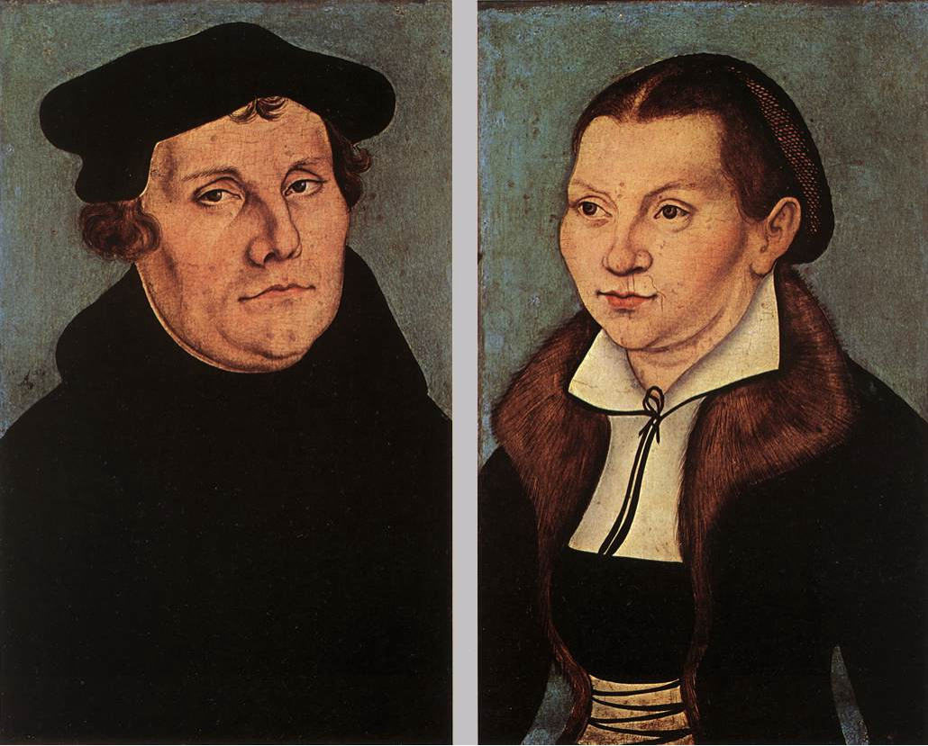
Martin Luther and James
James "contradicted" Paul
James is "a right strawy epistle"
James shouldn't be in the Bible

Slide 51
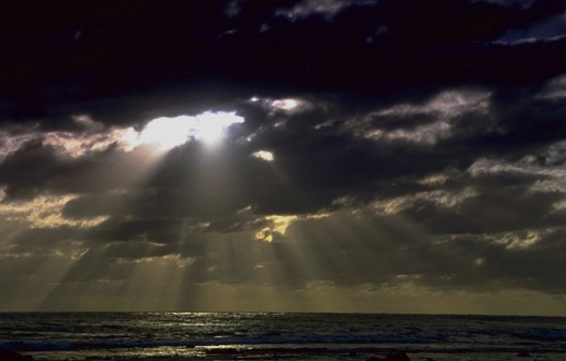
James 2:17
"In the same way,
faith by itself,
if it is not accompanied by action,
is dead."
James 2:17

Slide 52


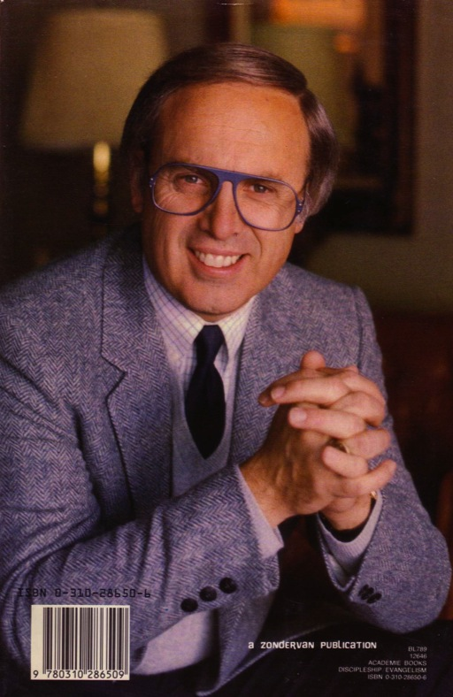

The Lordship Salvation Debate
Accept Christ as…
Savior & Lord
Savior then Lord
Savior alone
SO GREAT
SALVATION
ABSOLUTELY
FREE!

Slide 53
If we are justified by faith alone, then what is the role of works?
Paul addresses one question: How is salvation experienced?
By faith alone
(Romans 3:28)
simple belief
James answers a different question: How is true and saving faith recognized?
By faith's fruits
(James 2:14-26)
Belief simply shown through works

Slide 54
Romans Versus James
272
Book
Romans
James
Author
Paul
James
Date
A.D. 56
A.D. 44-48
Justification is a
technical term
non-technical term
Justification is before
God (vertical)
Man (horizontal)
The faith is
at beginning of salvation
after salvation
Emphasis is upon
faith
works

Slide 55
The Main Idea of James 2:14-26
Others see genuine faith in works!

Slide 56
Will each genuine Christian persevere in faithfulness at death?
274i
Yes
No
Reformed
Partakers
Arminian
Apostasy
Cannot Happen
Apostasy Leads to Loss of Rewards
Apostasy Leads to Loss of Salvation
Eternal Security but No Assurance
Eternal Security
and Assurance
No Eternal Security and No Assurance

Slide 57
Slides on
James 3

Slide 58
James Shows Ways Faith is Seen…
267

Slide 59
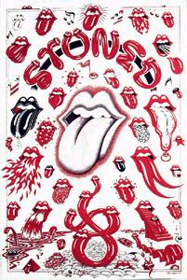
Controlling the Tongue (3:1-18)
How to have victory over one of our toughest enemies

Slide 60
True bulletin announcements…
Don't let worry kill you—let the church help.
Thursday night Potluck Supper. Prayer and medication to follow.
Remember in prayer the many who are sick of our church and community.
For those of you who have children and don't know it, we have a nursery downstairs.
The ladies of our church have cast off clothing of every kind and they may be seen in the church basement Friday.

Slide 61
True bulletin announcements…
The rosebud on the altar this morning is to announce the birth of David Allen Belzer, the sin of Rev. and Mrs. Julius Belzer.
This afternoon there will be a meeting in the south and north ends of the church. Children will be baptized at both ends.
The bean supper will be held Tuesday evening in the church hall. Music will follow.
At the evening service tonight, the sermon topic will be "What is Hell?" Come early and listen to our choir practice.

Slide 62
What does this say?
MR PIGS
MR NOT PIGS!
OSAR
CM PENS?
LIB
MR PIGS!
Them are pigs
Them are not pigs!
Oh, yes they are!
See them pens?
Well I'll be!
Them are pigs!
Watch your words!
Notes:
You have to say this with a Southern accent from the USA as an argument between two people.

Slide 63
Faith speaks wisely because faith…
3:1-6 Recognizes the influence of the tongue

Slide 64
"The tongue is a fire, a world of evil among the parts of the body. It corrupts the whole person, sets the whole course of his life on fire, and is itself set on fire by hell" (3:6)

Slide 65
Faith speaks wisely because faith…
3:1-6 Recognizes the influence of the tongue
3:7-8 Recognizes the tongue as untamable

Slide 66
Faith speaks wisely because faith…
3:1-6 Recognizes the influence of the tongue
3:7-8 Recognizes the tongue as untamable
3:9-12 Uses the tongue for good, not evil

Slide 67
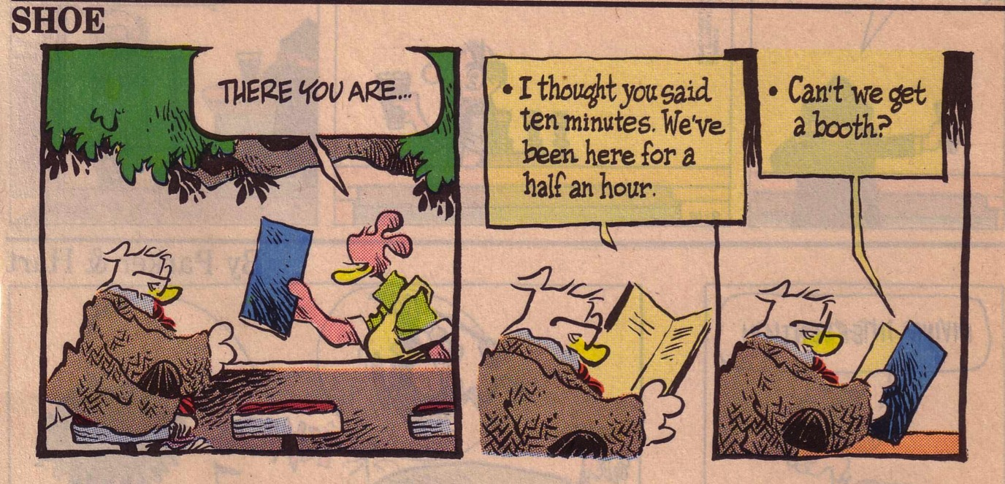
Whine List 1

Slide 68
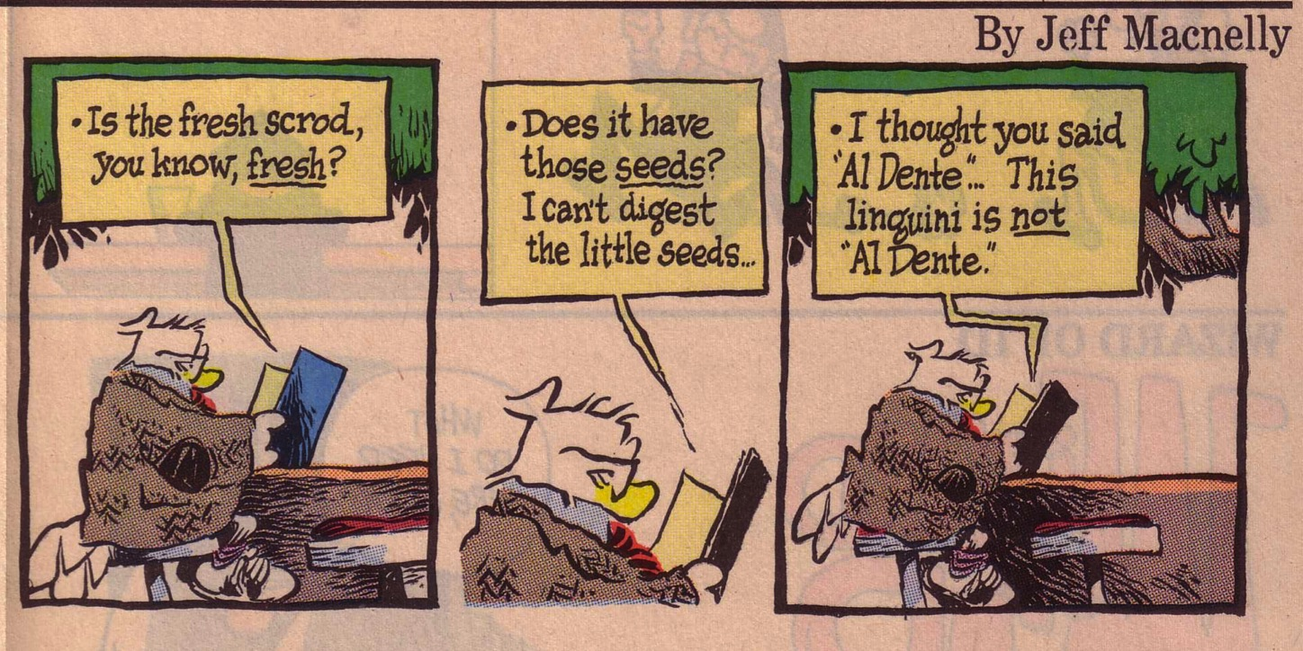
Whine List 2

Slide 69
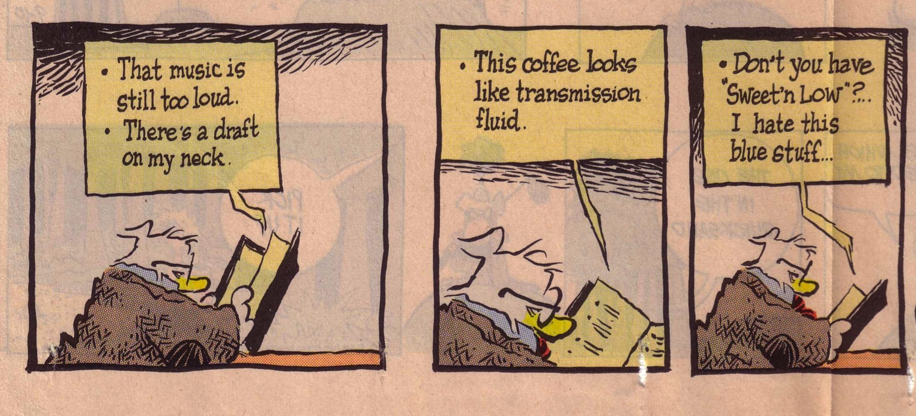
Whine List 3

Slide 70
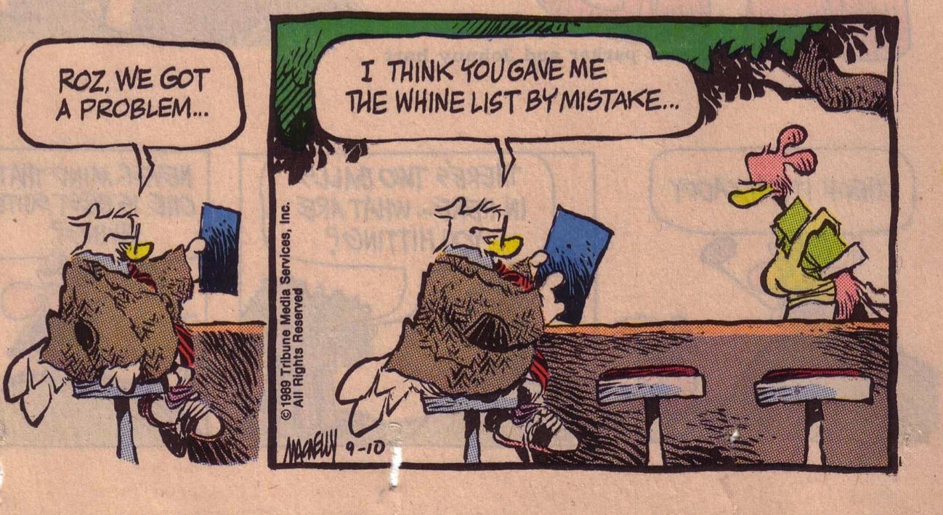
Whine List 4

Slide 71
Faith speaks wisely because faith…
3:1-6 Recognizes the influence of the tongue
3:7-8 Recognizes the tongue as untamable
3:9-12 Uses the tongue for good, not evil
3:13-18 Produces wisdom for proper speech

Slide 72
Where does wisdom come from?
How does James define wisdom?
There are two kinds of wisdom…

Slide 73
The Two Wisdoms
3:15-16
  3:17-18
Origin
not from above
earthly
unspiritual
devilish
from above
Characteristics
envy
selfish ambition
pure
peace loving
considerate
submissive
merciful & good fruit
impartial
sincere
Results
disorder
every evil practice
harvest of righteousness

Slide 74
James Shows Ways Faith is Seen…
267

Slide 75
Slides on
James 4

Slide 76
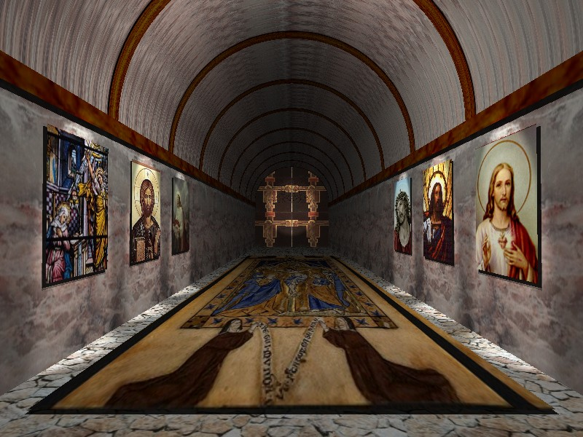
James 4:4 (NIV)
“You adulterous people, don't you know that friendship with the world is hatred toward God? Anyone who chooses to be a friend of the world becomes an enemy of God.”

Slide 77
Discernment v. Judgment
Commanded
Prohibited
Asks questions
Accepts hearsay
Self-evaluation
Others-evaluation
Humble
Proud
Protects
Discredits

Slide 78
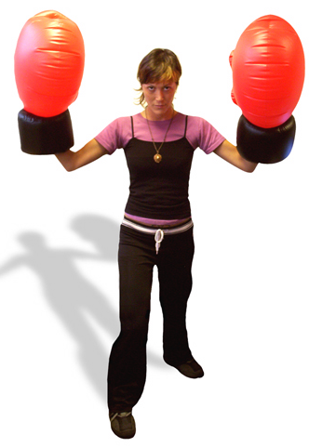
4:1-12 Summary
Don't follow evil desires (1-10)
Don't judge (11-12)

Slide 79

Planning and Faith
Planning and Faith
How not to play God
(James 4:13-17)

Slide 80

How to Play God
With Others (4:11-12)
  Slander them (11)
  Judge them (12)
With Ourselves (4:13-17)
Adapted from Charles Swindoll, James Bible Study Guide (Insight for Living, 1983), 70-71

Slide 81
Rules to Play God (4:13)
Choose your own time and schedule
Select your own location (the place you like)
Limit your stay to please yourself
Arrange your activities to please yourself
Predict your outcome and boast about it
Adapted from Charles Swindoll, James Bible Study Guide (Insight for Living, 1983), 71

Slide 82
The True God's Evaluation
You don't know what will happen tomorrow (14a)
You don't know if you'll have a long life (14b)
You have no right to ignore God's will (15-17)

Slide 83
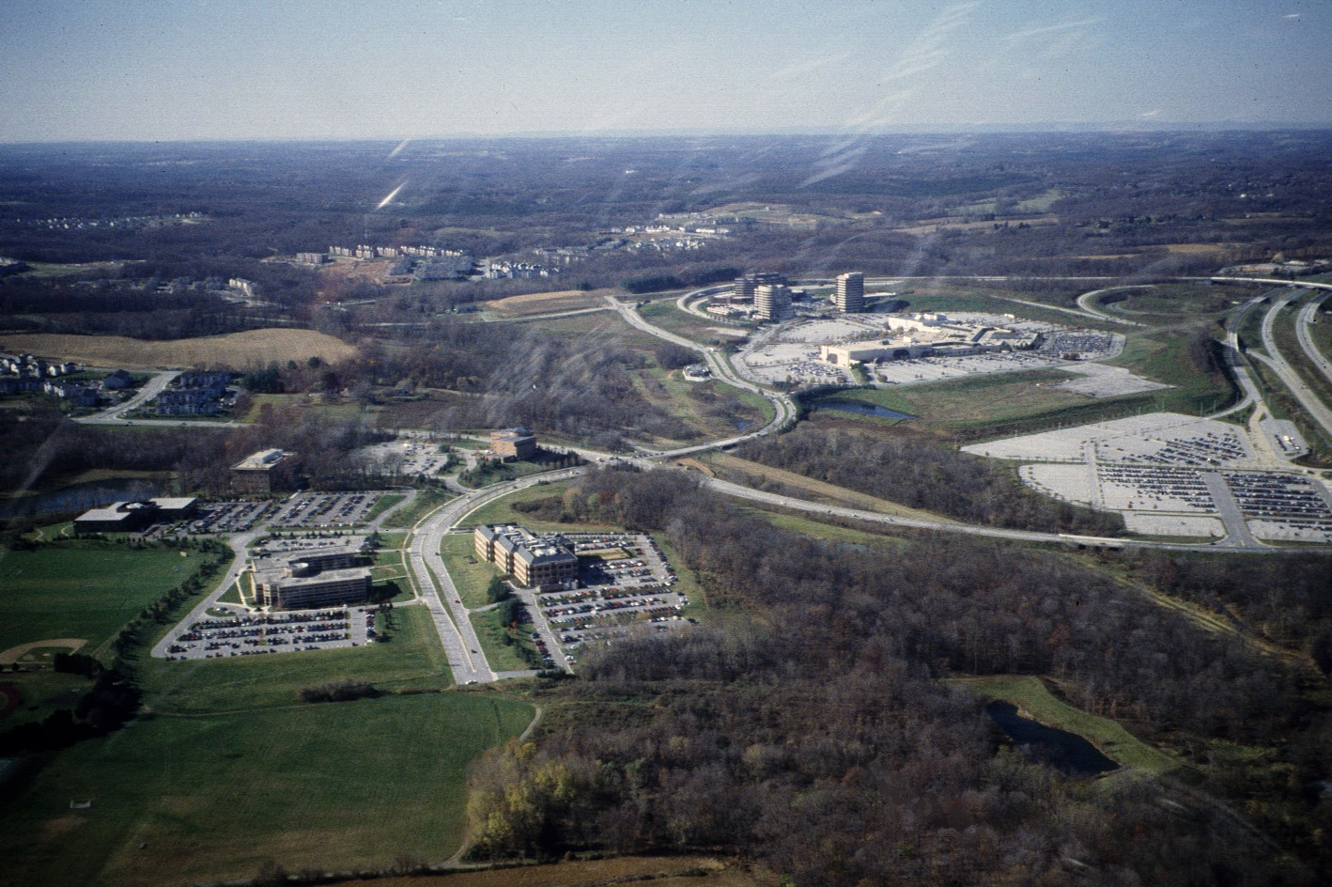
What plan do you need to submit to God?

Slide 84
Slides on
James 5

Slide 85
Warnings to the Wealthy
(James 5:1-6)

Slide 86
Four types of people…
Spiritually poor & materially poor
Spiritually rich & materially rich
Spiritually rich & materially poor
Spiritually poor & materially rich
James addresses this last group.

Slide 87
To Bring Home
Are you among the rich or the poor of the world? How do you know this?
What luxuries or conveniences could you share with others? Think of things you tend to waste or not put to greater use.
What should you do with the hard-hitting words of James?

Slide 88
James Shows Ways Faith is Seen…
267

Slide 89
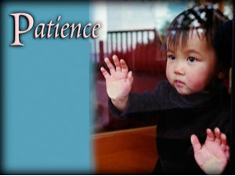
How patient are you?
I get frustrated when using a slow computer
When God doesn't answer my prayers, I give up praying that request
At the grocery I still use the express lane when I have more than 6 items
I stand as close as I can to be first in doors on lifts, MRT trains, buses, etc.

Slide 90

How patient are you?
I expect an answer to my emails within 24 hours
When calling someone, I hang up the phone after three rings
I get angry when someone on the road cuts me off (when driving, in a taxi, or walking)
I get annoyed when forced to take self-evaluation tests (like this one)

Slide 91
How Can We Be Patient?
Look to the Lord's return (5:7)
Quit complaining to others (5:9)
Stop making rash promises (5:12)
Imitate examples of perseverance (5:7, 10, 11)

Slide 92
Divine Healing Today
What should we do when we need physical healing?

Slide 93

AOG Official Doctrine
"Divine healing is an integral part of the gospel. Deliverance from sickness is provided for in the atonement, and is the privilege of all believers (Isaiah 53:4,5; Matthew 8:16,17; James 5:14-16)"
(The Assemblies of God Constitution in its Statement of Fundamental Truths, section 12, emphasis mine)
http://ag.org/top/beliefs/position_papers/4184_healing.cfm
Notes:
This statement on divine healing was adopted by the Assemblies of God General Presbytery, August 20, 1974 (http://ag.org/top/beliefs/position_papers/4184_healing.cfm)

Slide 94

Pray, Pray, Pray
"Is any one of you in trouble? He should pray. Is anyone happy? Let him sing songs of praise. Is anyone sick? He should call the elders of the church to pray over him…"
(James 5:13-14)

Slide 95
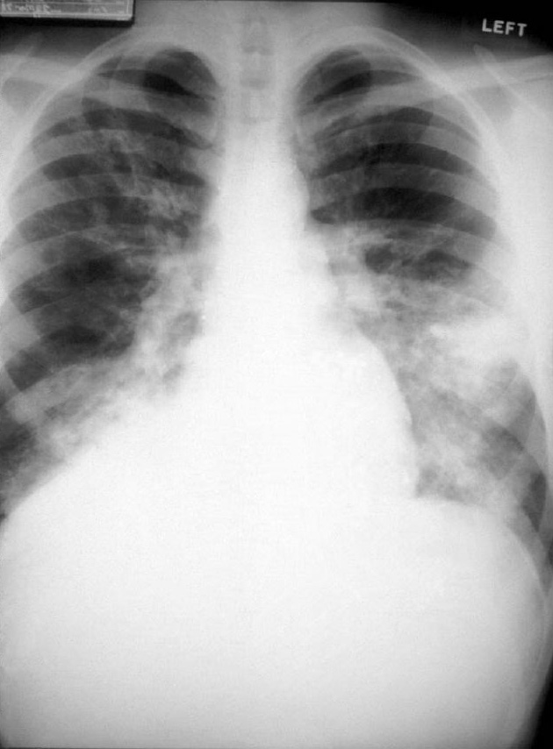
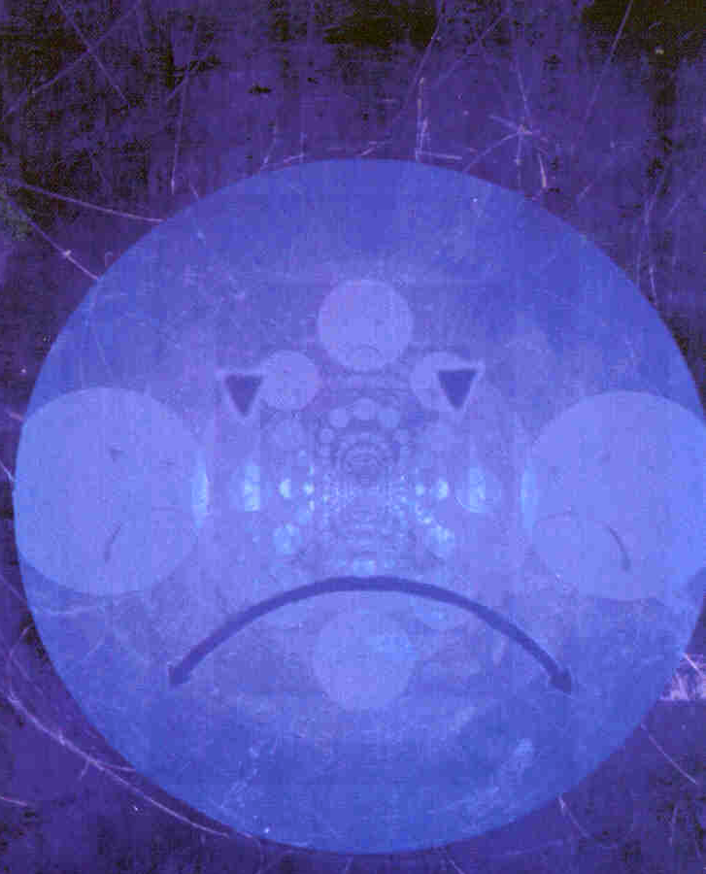
What Kind of Sickness?
Asthenei
Weak Faith
Physical Illness
General word for "to be weak"
Used this way in many passages (e.g., Acts 20:35 "we must help the weak")
James 5:15 better translated "make the weary person well" (cf. Heb. 12:3)
Contrasts with "in trouble" (5:13) by narrowing to physical issues
Need for elders
Use of oil
"restore" and "raise up" are physical

Slide 96

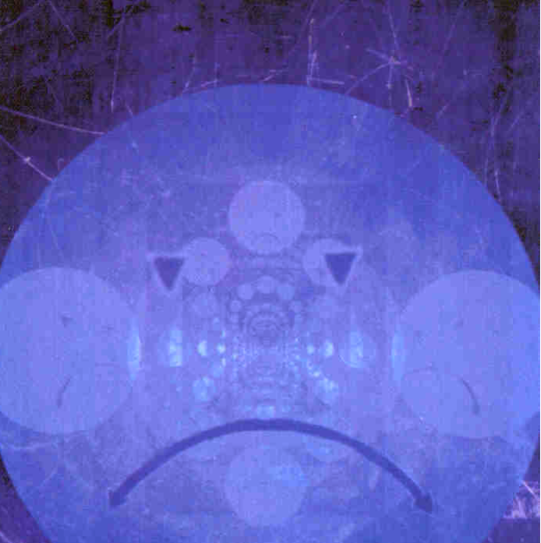
What Kind of Anointing?
Mundane
Sacred
General word for "to rub with oil"
Contrasts with a word not used, which is chrio ("ceremonially anoint")
Greek participle shows that prayer, not anointing, is the primary act

Slide 97


Does the Prayer Work?
"the prayer will restore… and the Lord will raise him up"
Yes
No
Prayer that God will heal emotional wounds is always successful
God does not always heal physically when we pray

Slide 98

The Problem of Pain
If God is good and all-powerful, why does he allow his creatures to suffer pain?

Slide 99
What should you do?
James 5

Slide 100
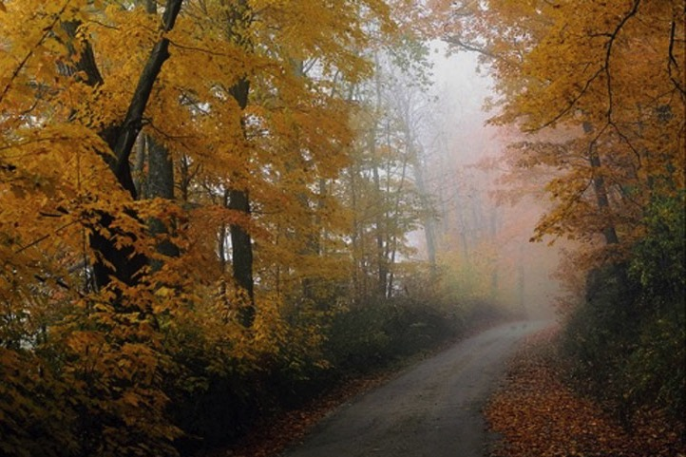
What's the road to healing?

Slide 101
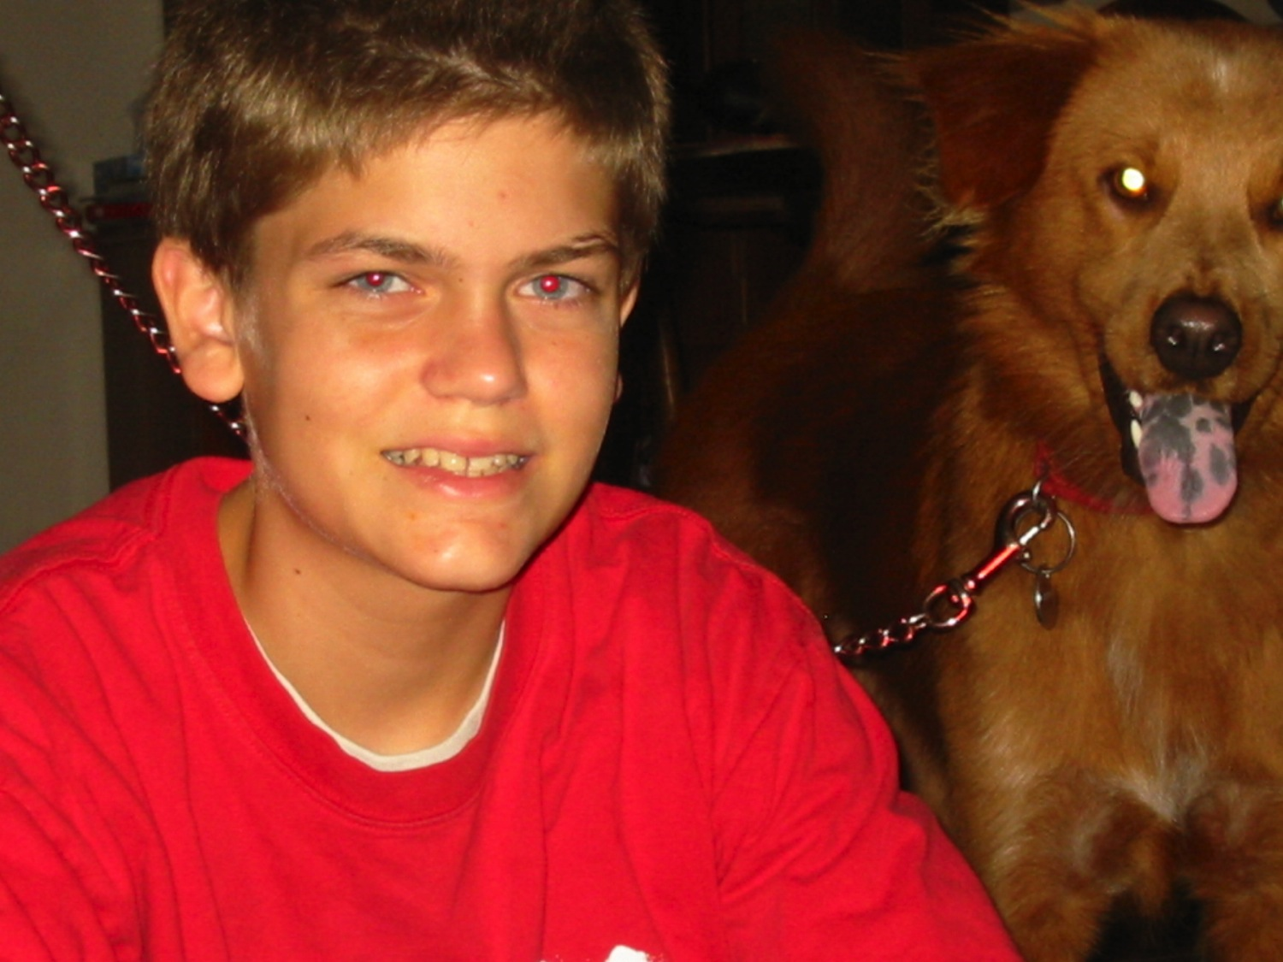
Our son Stephen suffered from Anklosing Spondylitis (ages 7-11)

Slide 102
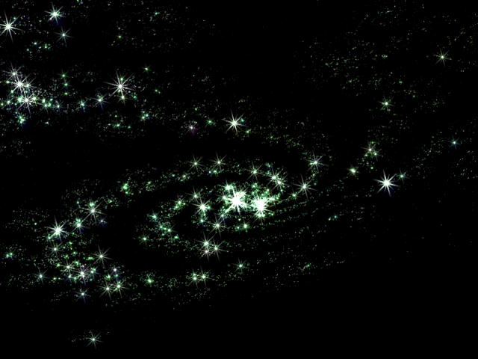
JAMES 5:19-20
¹⁹My brothers, if one of you should wander from the truth and someone should bring him back, ²⁰remember this: Whoever turns a sinner from the error of his way will save him from death and cover over a multitude of sins.

Slide 103
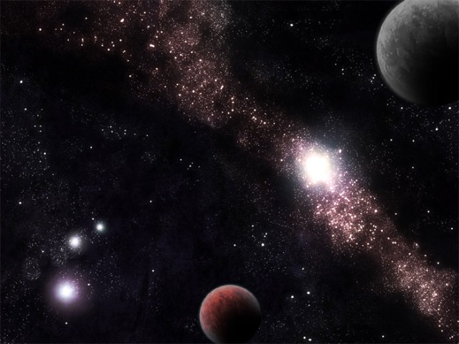
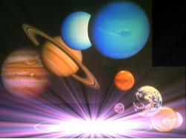
Who are the wanderers?
planao lead astray, mislead, deceive; pass. stray away, go astray; be mistaken; be deceived or misled; wander about
This refers to Christians who reject the will of God by straying from the truth by their behavior in an active, not passive sense

Slide 104

Making this Text Real to Me
Whom do I need to help restore?
How will I do it?

Slide 105
What are the characteristics of faith?
7
Notes:
What should your trust in Christ look like?
What does faith in Jesus look like?

Slide 106
Main Idea of James
IF YOU BELIEVE
SHOW IT

Slide 107
James Shows Ways Faith is Seen…
267
Notes:
Today we briefly saw seven characteristics of faith (Main Points). Which one relates to you today?

Slide 108
Black

Slide 109


NT Preaching • BibleStudyDownloads.org
Get this presentation and script for free!

